Slide 1
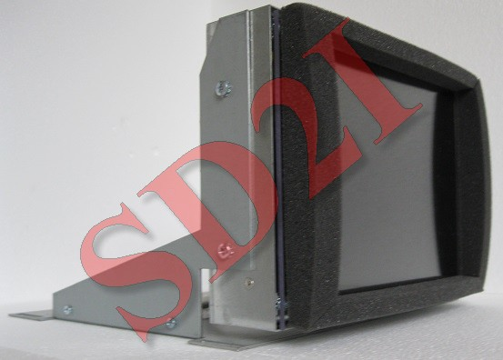
Specification
CNC-
CYBELDNC34PS-
084
Technical specification :
Power supply input
12VDC
Power consumption
20W maximum
Frequency range
15kHz-60kHz horizontal –
50-80 Hz vertical
Input signals
Video analogique 0.7 V~1 Vpp
75 Ohm or TTL
Synchronization
On Green
Level 0.3Vpp For analog
Or TTL sync Comp and Sep
Input connector
RS170
Operating conditions
Temperature : 0°C +50°C
Humidity : 10% 80%
Resolution
800X600
Brightness
450Cd
Contrast
600 : 1
Dot pitch
0.213mm
Response time
35mS
Viewving angle
160/140 R-L/U-D
S.D.2I – Tél : 01 69 52 28 60 – Fax : 09 71 70 60 12 – email : sd2i@orange.fr – Web : solutiondeveloppement.com
23 Bld DUMAY DELILLE – 91230 MONTGERON
NII FR21 4910009056 – SIRET 491000905600012 – APE : 7112B

